Slide 1
Computer Systems B COMS20012
Introduction to Operating Systems and Security

Slide 2
Translation Lookaside Buffer

Slide 3
Previously
Virtual Address
Problem
One virtual memory access
Requires two physical memory access
Load directory entry
Load page entry
Generate “real” memory access
directory #
page #
offset
directory entry
page entry
directory entry
page entry
directory entry
page entry
directory entry
page entry
Page directory
Page table
Physical Address
%cr3
page #
offset

Slide 4
Previously
Virtual Address
Problem
One virtual memory access
Requires two physical memory access
Load directory entry
Load page entry
Generate “real” memory access
What a computer scientist do?
directory #
page #
offset
directory entry
page entry
directory entry
page entry
directory entry
page entry
directory entry
page entry
Page directory
Page table
Physical Address
%cr3
page #
offset

Slide 5
Previously
Virtual Address
Problem
One virtual memory access
Requires two physical memory access
Load directory entry
Load page entry
Generate “real” memory access
What a computer scientist do?
Add some cache!
directory #
page #
offset
directory entry
page entry
directory entry
page entry
directory entry
page entry
directory entry
page entry
Page directory
Page table
Physical Address
%cr3
page #
offset

Slide 6
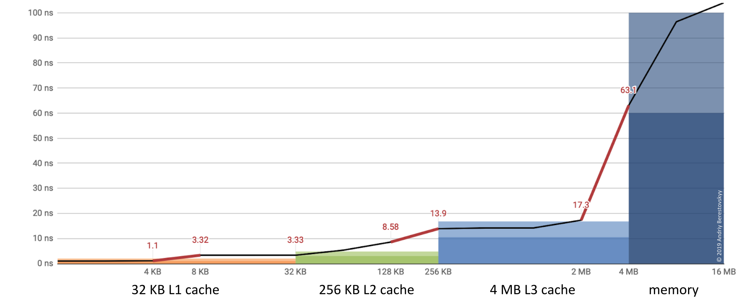
Translation Lookaside Buffer (TLB)
Cache some PTE in hardware buffer
No need to go to physical memory to fetch PTE
Hardware memory is way faster than main memory!
We can also be clever about caching!

Slide 7
Translation Lookaside Buffer (TLB)
Core
Core
Key/value store:
Key high bits of virtual address
Value is physical frame number
TLB
TLB
L1 i-cache
L1 d-cache
L1 i-cache
L1 d-cache
L2 cache
L2 cache
L3 cache
RAM

Slide 8
Why does this work?
Program exhibit nice locality property
Temporal locality: when a process accesses virtual address x, it is likely to access it again in the future (e.g., variable on the stack)
Spatial locality: when a process accesses a virtual address x, the process is likely to address other addresses close to x (e.g., reading elements of an array on the heap)

Slide 9
Memory lifecycle on x86
Virtual address
TLB Look up
TLB hit?
HW walk page table
Check protection bits
Found PTE?
Access Ok?
HW update TLB
HW page fault
HW page fault
Calculate phys. address, send to L1/L2/L3/RAM

Slide 10
Memory lifecycle on x86
Virtual address
Before raising fault, hardware set
register %cr2 to faulting address
and push error to stack:
Page not present in physical memory
Wrong access (e.g., writing on read only)
TLB Look up
TLB hit?
HW walk page table
Check protection bits
Found PTE?
Access Ok?
HW update TLB
HW page fault
HW page fault
Calculate phys. address, send to L1/L2/L3/RAM

Slide 11
Memory lifecycle on MIPS
Virtual address
TLB Look up
TLB hit?
HW exception #2 or #3 TLB miss on load
miss on store
Check protection bits
Access Ok?
Software logic
HW exception #1
read only fault
Calculate phys. address, send to L1/L2/L3/RAM

Slide 12
TLB design trade-offs
Software TLB
Good: freedom to design page directory, page tables and other structures as needed
Good: OS can implement TLB eviction policies (i.e., deciding which entry to remove when full)
Bad: slower than hardware
Hardware TLB
Good: faster!
Bad: OS cannot change the design of page directory, page table etc.

